Slide 1

Module – 2 : Software Design
Software Engineering (SE) → CSEN3202 – CSE/BTech/6th Semester → Module-II → Prepared by : Nilina Bera, CSE, HITK

Slide 2
Software Design
The activities carried out during the design phase (called the design process) transform the SRS document into the design document. Thus, the features essential for a good software design are:
a) Correctness
b) Efficiency
c) Maintainability
d) All of above
Ans: d)
11/07/26 11/07/26
Nilina Bera

Slide 3
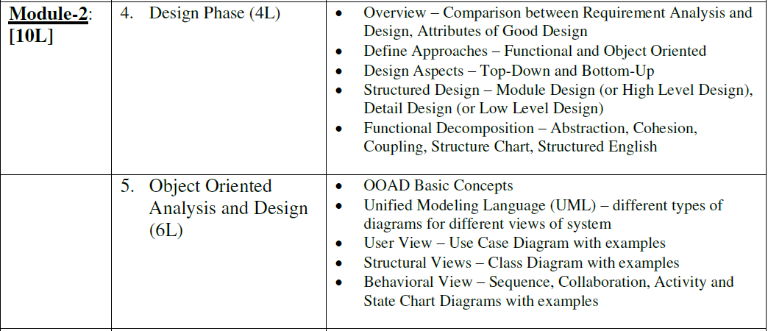
11/07/26 11/07/26
Nilina Bera

Slide 4
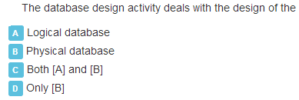
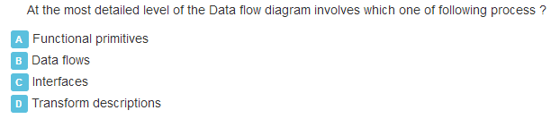
Self assessment
11/07/26 11/07/26
Nilina Bera

Slide 5
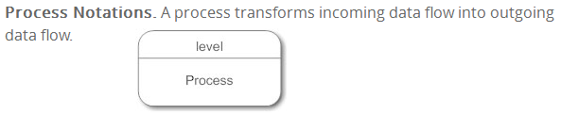
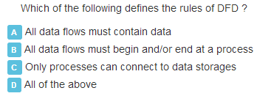
Transform descriptions in Data Flow diagrams
11/07/26 11/07/26
Nilina Bera

Slide 6
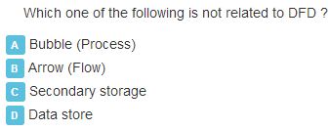
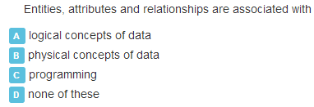
Self assessment
11/07/26 11/07/26
Nilina Bera

Slide 7
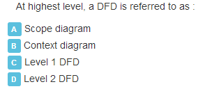
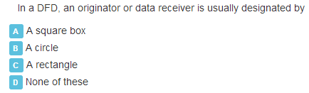

Self assessment
11/07/26 11/07/26
Nilina Bera

Slide 8
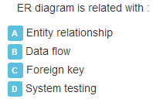

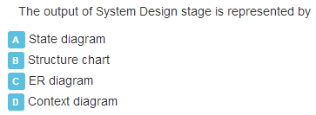
Self assessment
11/07/26 11/07/26
Nilina Bera

Slide 9
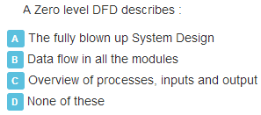
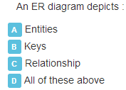
Self assessment
11/07/26 11/07/26
Nilina Bera

Slide 10
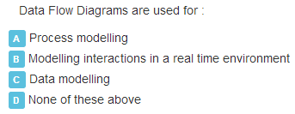
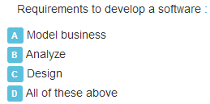
Self assessment
11/07/26 11/07/26
Nilina Bera

Slide 11
What is a good program?
nilina@nilina-HP-Pro-3330-MT:~/Desktop/ds$ ./bst
Press 1 to Create BST
Press 2 to insert element in BST
Press 3 to Display (Inorder+POstOrder)
Press 4 to Search maxELEMENT
Press 5 to Search minELEment
Press 6 to Delete element
Press 7 to Exit
Please Enter your Choice:
Structural: To develop a program, the task must be broken down into a number of subtasks. These subtasks are developed independently, and each subtask is able to perform the assigned job without the help of any other subtask. If a program is developed structurally, it becomes more readable, and the testing and documentation process also gets easier.
11/07/26 11/07/26
Nilina Bera

Slide 12
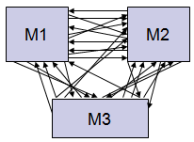
Characteristics of Good Design
Component independence
  High cohesion
  Low coupling
Exception identification and handling
Fault prevention and fault tolerance
Design for change

Slide 13
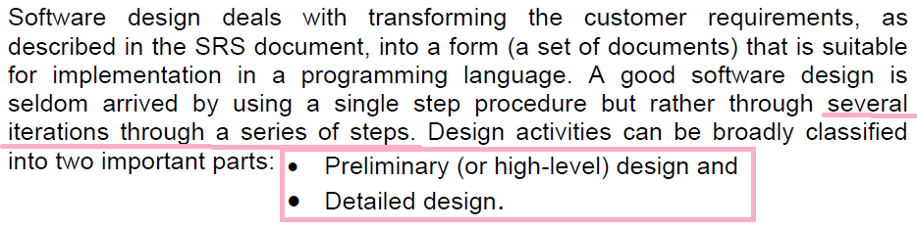
Let’s start Software Design…..
Software design and its activities ::
Difference between analysis and design ::
The aim of analysis is to understand the problem with a view to eliminate any deficiencies in the requirement specification such as incompleteness, inconsistencies, etc.
The aim of design is to produce a model that will provide a seamless transition to the coding phase, i.e. once the requirements are analyzed and found to be satisfactory, a design model is created which can be easily implemented.

Slide 14
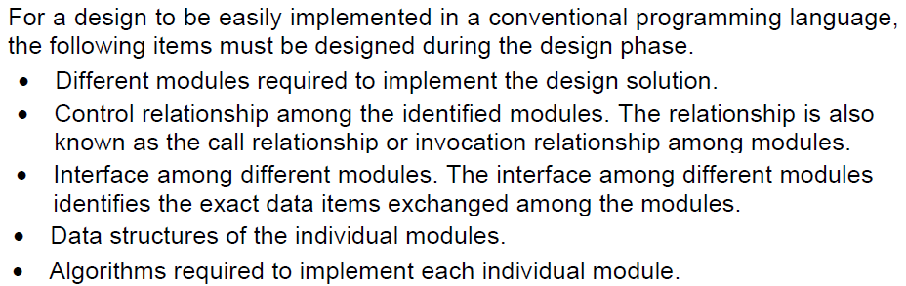
Items developed during the software design phase
How can we Characterize a good software design ?
• Correctness: A good design should correctly implement all the functionalities identified in the SRS document.
• Understandability: A good design is easily understandable
Efficiency: It should be efficient.
Maintainability: It should be easily amenable (compliant) to change.
11/07/26 11/07/26
Nilina Bera

Slide 15
Understandability of a design – a major concern :
Given that we choose from only correct design solutions, understandability of a design solution is possibly the most important issue to be considered while judging the goodness of a design.
An understandable design is modular and layered
How can the understandability of two different designs be compared, so that we can pick the better one?
It should use consistent and meaningful names for various design components.
• The design should be modular. The term modularity means that it should use a cleanly decomposed set of modules.
• It should neatly arrange the modules in a hierarchy, e.g. in a tree-like diagram.
11/07/26 11/07/26
Nilina Bera

Slide 16
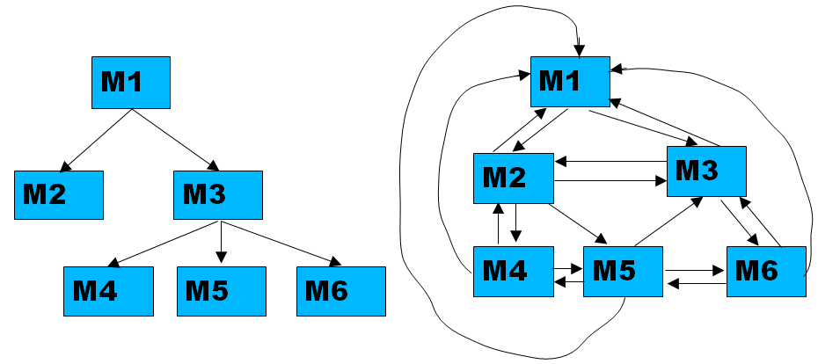
An understandable design is modular and layered
Modularity: A modular design achieves effective decomposition of a problem. If different modules have either no interactions or little interactions with each other, then each module can be understood separately.
A modular and hierarchical design
A design solution exhibiting poor modularity and hierarchy
11/07/26 11/07/26
Nilina Bera

Slide 17
An understandable design……
Modularity: A design solution is considered to be highly modular, if the different modules in the solution have high cohesion and their inter-module couplings are low.
Cohesion refers to the degree to which the elements of a module/class belong together, suggestion is all the related code should be close to each other, so we should strive for high cohesion and bind all related code together as far as possible. It has to do with the elements within the module/class.
Coupling refers to the degree to which the different modules/classes depend on each other, suggestion is all modules should be independent as far as possible, that's why low coupling. It has to do with the elements among different modules/classes.
11/07/26 11/07/26
Nilina Bera

Slide 18
Cohesion & Coupling
Most researchers and engineers agree that a good software design implies clean decomposition of the problem into modules, and the neat arrangement of these modules in a hierarchy.
The primary characteristics of neat module decomposition are high cohesion and low coupling.
Cohesion is a measure of functional strength of a module.
A module having high cohesion and low coupling is said to be functionally independent of other modules.
By the term functional independence, we mean that a cohesive module performs a single task or function.
A functionally independent module has minimal interaction with other modules.
11/07/26 11/07/26
Nilina Bera

Slide 19
Type of Cohesion
High Cohesion
Functional
Sequential
Communicational
Procedural
Temporal
Logical
Coincidental
Low

Slide 20
Functional
Sequential
Communicational
Procedural
Temporal
Logical
Coincidental
Coincidental Cohesion
Def: Parts of the component are unrelated (unrelated functions, processes, or data)
Parts of the component are only related by their location in source code.
Elements needed to achieve some functionality are scattered throughout the system.
Accidental
Worst form

Slide 21
Example
Print next line
Reverse string of characters in second argument
Add 7 to 5th argument
Convert 4th argument to float

Slide 22
Functional
Sequential
Communicational
Procedural
Temporal
Logical
Coincidental
Logical Cohesion
Def: Elements of component are related logically and not functionally.
Several logically related elements are in the same component and one of the elements is selected by the client component.

Slide 23
Example
A component reads inputs from tape, disk, and network.
All the code for these functions are in the same component.
Operations are related, but the functions are significantly different.
Improvement?

Slide 24
Temporal Cohesion
Functional
Sequential
Communicational
Procedural
Temporal
Logical
Coincidental
Def: Elements are related by timing involved
Elements are grouped by when they are processed.
Example: An exception handler that
  Closes all open files
  Creates an error log
  Notifies user
  Lots of different activities occur, all at same time

Slide 25
Example
A system initialization routine: this routine contains all of the code for initializing all of the parts of the system. Lots of different activities occur, all at init time.
Improvement?

Slide 26
Functional
Sequential
Communicational
Procedural
Temporal
Logical
Coincidental
Procedural Cohesion
Def: Elements of a component are related only to ensure a particular order of execution.
Actions are still weakly connected and unlikely to be reusable.
Example:
  ...
  Write output record
  Read new input record
  Right/Left Pad input with spaces
  Return new record
  ...

Slide 27
Functional
Sequential
Communicational
Procedural
Temporal
Logical
Coincidental
Communicational Cohesion
Def: Functions performed on the same data or to produce the same data.
Examples:
  Update record in database and send it to the printer
    Update a record on a database
    Print the record
  Fetch unrelated data at the same time.
    To minimize disk access

Slide 28
Functional
Sequential
Communicational
Procedural
Temporal
Logical
Coincidental
Sequential Cohesion
Def: The output of one part is the input to another.
Data flows between parts (different from procedural cohesion)
Occurs naturally in functional programming languages
Good situation

Slide 29
Functional
Sequential
Communicational
Procedural
Temporal
Logical
Coincidental
Functional Cohesion
Def: Every essential element to a single computation is contained in the component.
Every element in the component is essential to the computation.
Ideal situation
What is a functionally cohesive component?
  One that not only performs the task for which it was designed but
  it performs only that function and nothing else.

Slide 30
Examples of Cohesion
Function A
Function A
Function A’
Function A’’
Time t₀
Time t₀ + X
Time t₀ + 2X
Function
B
Function
C
logic
Function
D
Function
E
Coincidental
Parts unrelated
Logical
Similar functions
Temporal
Related by time
Function A
Function B
Function C
Procedural
Related by order of functions

Slide 31
Examples of Cohesion (Cont.)
Function A
Function B
Function C
Function A
Function B
Function C
Communicational
Access same data
Sequential
Output of one is input to another
Function A part 1
Function A part 2
Function A part 3
Functional
Sequential with complete, related functions

Slide 32
Coupling
Coupling between two modules is a measure of the degree of interdependence or interaction between the two modules.
A module having high cohesion and low coupling is said to be functionally independent of other modules.
If two modules interchange large amounts of data, then they are highly interdependent.
The degree of coupling between two modules depends on their interface complexity.
11/07/26 11/07/26
Nilina Bera

Slide 33
Coupling
The degree of dependence such as the amount of interactions among components
No dependencies
Loosely coupled
some dependencies
Highly coupled
many dependencies

Slide 34
Type of Coupling
High Coupling
Content
Common
External
Control
Stamp
Data
Uncoupled
Avoid
Loose
Try to achieve
Low

Slide 35
Content
Common
External
Control
Stamp
Data
Uncoupled
Content Coupling
Def: One component modifies another.
Example:
  Component directly modifies another’s data
  Component modifies another’s code, e.g., jumps (goto) into the middle of a routine
Question
  Language features allowing this?

Slide 36
Example
Part of a program handles lookup for customer.
When customer not found, component adds customer by directly modifying the contents of the data structure containing customer data.
Improvement?

Slide 37
Common Coupling
Content
Common
External
Control
Stamp
Data
Uncoupled
Def: More than one component share data such as global data structures
Usually a poor design choice because
  Lack of clear responsibility for the data
  Reduces readability
  Difficult to determine all the components that affect a data element (reduces maintainability)
  Difficult to reuse components
  Reduces ability to control data accesses

Slide 38
Example
Process control component maintains current data about state of operation. Gets data from multiple sources. Supplies data to multiple sinks. Each source process writes directly to global data store. Each sink process reads directly from global data store.
Improvement?

Slide 39
Content
Common
External
Control
Stamp
Data
Uncoupled
External Coupling
Def: Two components share something externally imposed, e.g.,
  External file
  Device interface
  Protocol
  Data format
Improvement?

Slide 40
Content
Common
External
Control
Stamp
Data
Uncoupled
Control Coupling
Def: Component passes control parameters to coupled components.
May be either good or bad, depending on situation.
  Bad if parameters indicate completely different behavior
  Good if parameters allow factoring and reuse of functionality
Good example: sort that takes a comparison function as an argument.
  The sort function is clearly defined: return a list in sorted order, where sorted is determined by a parameter.

Slide 41
Content
Common
External
Control
Stamp
Data
Uncoupled
Stamp Coupling
Def: Component passes a data structure to another component that does not have access to the entire structure.
Requires second component to know how to manipulate the data structure (e.g., needs to know about implementation).
The second has access to more information that it needs.
May be necessary due to efficiency factors: this is a choice made by insightful designer, not lazy programmer.
Notes:
.

Slide 42
Example
Customer Billing System
The print routine of the customer billing accepts customer data structure as an argument, parses it, and prints the name, address, and billing information.
Improvement?

Slide 43
Content
Common
External
Control
Stamp
Data
Uncoupled
Data Coupling
Def: Component passes data (not data structures) to another component.
Every argument is simple argument or data structure in which all elements are used
Good, if it can be achieved.
Example: Customer billing system
  The print routine takes the customer name, address, and billing information as arguments.
CS 4311

Slide 44
Functional independence
A module having high cohesion and low coupling is said to be functionally independent of other modules. By the term functional independence, we mean that a cohesive module performs a single task or function. A functionally independent module has minimal interaction with other modules.
Need for functional independence
Functional independence is a key to any good design due to the following reasons:
• Error isolation: Functional independence reduces error propagation. The reason behind this is that if a module is functionally independent, its degree of interaction with the other modules is less. Therefore, any error existing in a module would not directly effect the other modules.
11/07/26 11/07/26
Nilina Bera

Slide 45
Need for functional independence
Scope of reuse: Reuse of a module becomes possible. Because each module does some well-defined and precise function, and the interaction of the module with the other modules is simple and minimal. Therefore, a cohesive module can be easily taken out and reused in a different program.
Understandability: Complexity of the design is reduced, because different modules can be understood in isolation as modules are more or less independent of each other.
11/07/26 11/07/26
Nilina Bera

Slide 46
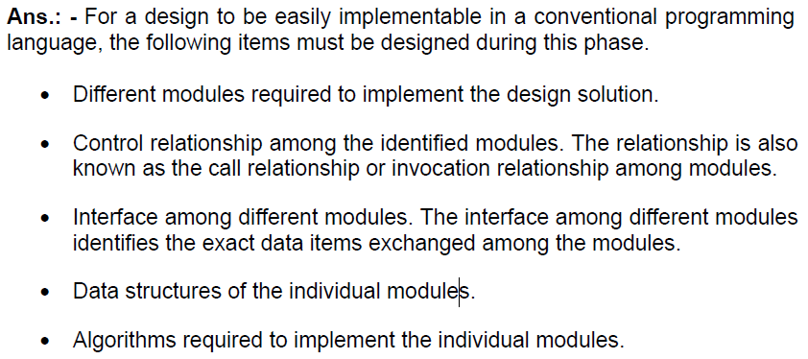
Let’s test our understanding…..
1. Identify at least five important items developed during software design phase.
11/07/26 11/07/26
Nilina Bera

Slide 47
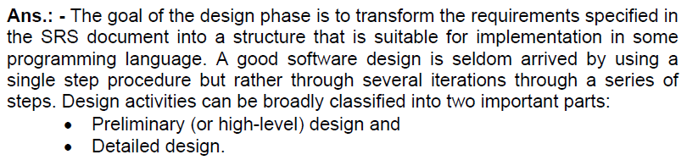
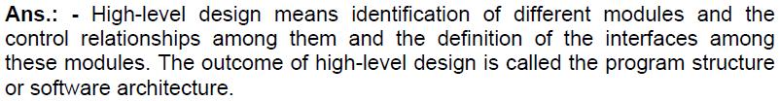
Let’s test our understanding…..
11/07/26 11/07/26
Nilina Bera

Slide 48
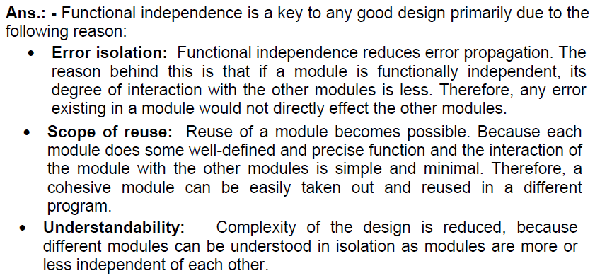
Let’s test our understanding…..
11/07/26 11/07/26
Nilina Bera

Slide 49
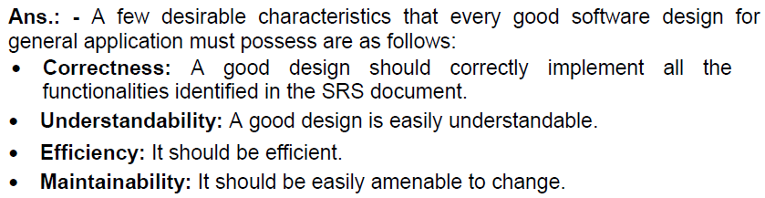
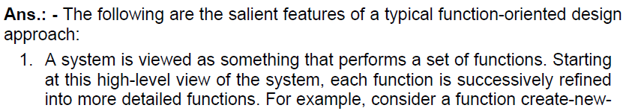
Let’s test our understanding…..
11/07/26 11/07/26
Nilina Bera

Slide 50
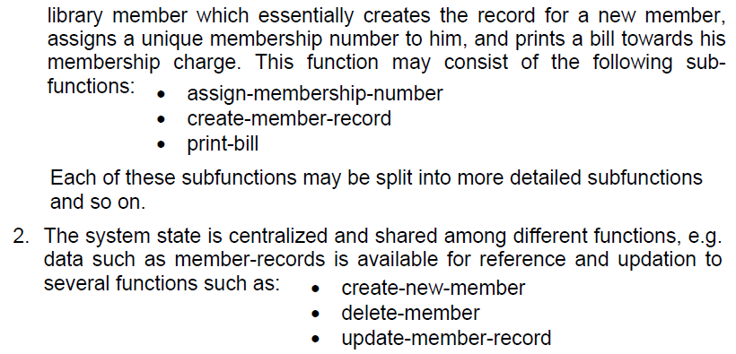
Let’s test our understanding…..
8. Identify at three least salient features of an object-oriented design approach.
9. Write down at least three differences between function-oriented and object-oriented design approach.
11/07/26 11/07/26
Nilina Bera

Slide 51
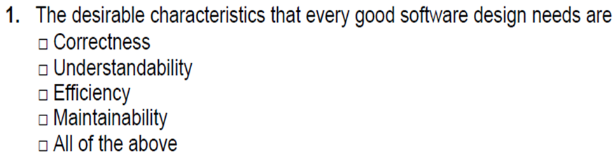
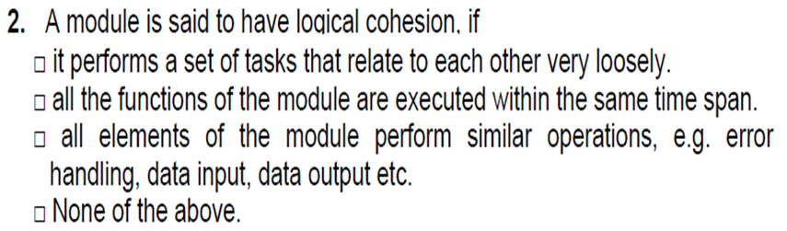
Multiple Choice Questions, Mark IT….
11/07/26 11/07/26
Nilina Bera

Slide 52
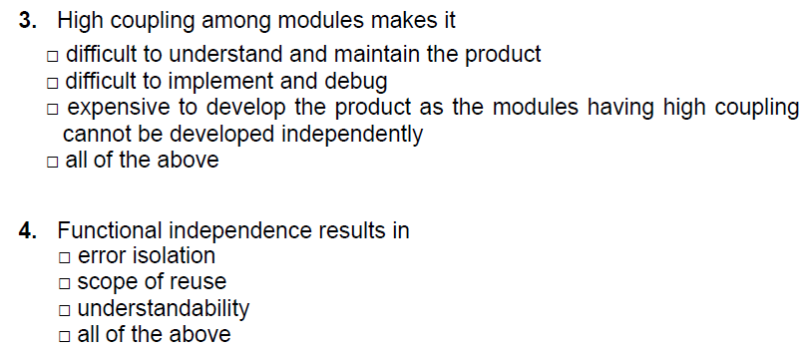
Multiple Choice Questions…..
11/07/26 11/07/26
Nilina Bera

Slide 53

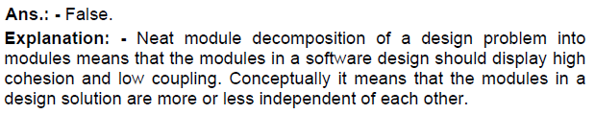
Mark the following as either True or False. Justify your answer.
11/07/26 11/07/26
Nilina Bera

Slide 54


True/False…..
11/07/26 11/07/26
Nilina Bera

Slide 55
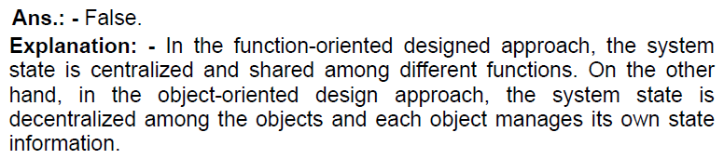
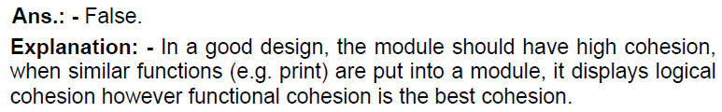
Multiple Choice Questions…..
Ans: True.
11/07/26 11/07/26
Nilina Bera

Slide 56
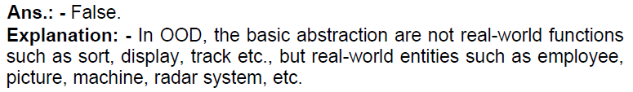

Let’s test our understanding…..
11/07/26 11/07/26
Nilina Bera

